Slide 1
VERSION CONTROL WITH GIT AND GITHUB

Slide 2

Keeping history of changes
The lame way
Multiple dated files with largely the same content
Periodically zipping files up into numbered/dated archives
The right way
Version control is the only reasonable way to keep track of changes in code, manuscripts, presentations, and data analysis projects
Backup of your entire project
Promotes transparency
Facilitates reproducibility
Faster recover from errors
Easier collaborations
“Piled Higher and Deeper” by Jorge Cham, http://www.phdcomics.com

Slide 3
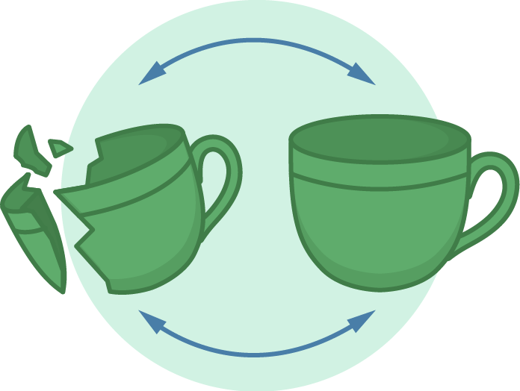
Why version control
Version control is not strictly necessary for reproducible research, and it’s admittedly some extra work (to learn and to use) in the short term, but the long term benefits are enormous
People are more resistant to version control than to any other tool, because of the short-term effort and the lack of recognition of the long-term benefits
Imagine that some aspect of your code has stopped working at somepoint. You know it was working in the past, but it’s not working now. How easy is it to figure out where the problem was introduced?
http://guides.beanstalkapp.com/version-control/getting-started-with-git.html

Slide 4

What is Git
Git is an open-source distributed version control system
Developed by Linus Torvalds (developer of Linux)
Distributed, distinct from centralized (subversion)
Authors can work asynchronously without being connected to a central server and synchronize their changes when possible
Complete audit trail of changes, including authorship
Freedom to explore new ideas without disturbing the main line of work
Collaborate with elegance – on any file at any time
https://git-scm.com/downloads

Slide 5
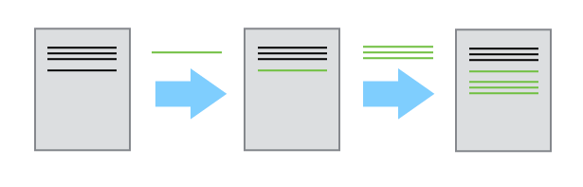
Sequential snapshots of incremental changes
Advantages of version control:
It’s easy to set up
Every copy of a Git repository is a full backup of a project and its history
A few easy-to-remember commands are all you need for most day-to-day version control tasks

Slide 6
STEPS IN VERSION CONTROL

Slide 7

First steps with Git
Download and install Git, https://git-scm.com/downloads. Do not install GUI client
man <command>. man git - not always good
git --help [<command>]
Setting up git
git config --global user.name "Your name here”
git config --global user.email your_email@example.com
git config --global color.ui “auto”
git config core.fileMode false
git config --list

Slide 8
Configuring text editor
Editor | Configuration command
nano | git config --global core.editor "nano -w"
vim | git config --global core.editor "vim"
Text Wrangler | git config --global core.editor "edit -w"
Sublime Text (Mac) | git config --global core.editor "subl -n -w"
Sublime Text (Win) | git config --global core.editor "'c:/program files/sublime text 2/sublime_text.exe' -w"
Notepad++ (Win) | git config --global core.editor "'c:/program files (x86)/Notepad++/notepad++.exe' -multiInst -notabbar -nosession -noPlugin"
Kate (Linux) | git config --global core.editor "kate"
Gedit (Linux) | git config --global core.editor "gedit -s"

Slide 9
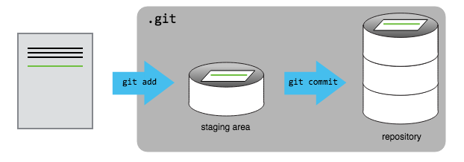
Git concepts
Two main concepts
commit - a recorded snapshot of differences you made to your project’s files
repository - the history of all your project’s commits
Files can be stored in a project’s working directory (which users see), the staging area (where the next commit is being built up) and the local repository (where revisions are permanently recorded)

Slide 10
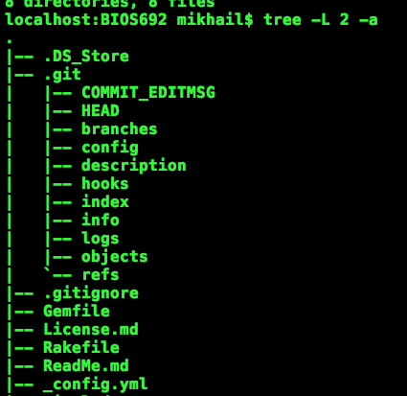
Starting git repository
Exercise:
Make a folder. Check with ls
git init - initializes a repository. .git folder contains all Git info - remove it and all will be lost
git status - to see the status of your repository.
Lifecycle of files in Git repository
Untracked
Modified
Staged
Committed

Slide 11
Tracking Changes
git add - puts files in the staging area
git commit - saves the changes in the files on staging area to the local repository. Always write an informative commit message when committing changes, "-m" flag
git status - shows the status of a repository

Slide 12
What to add
New repository from scratch
The first file to create (and add and commit) is probably a README.md file, either as plain text or with Markdown, describing the project
A new repo from an existing project
Say you’ve got an existing project that you want to start tracking with git. Go into the directory containing the project
Type git init – itinializes empty repository
Type git add <file> [<file> <file> …] - start tracking all the relevant files
Type git commit – saves the snapshot of your current files

Slide 13
What’s not to add
git add ., git add –u – add all the changes (updates) in your files
Don’t include files that are derived from other files in the repository
Be careful about committing binary files, or really big files. Git works best with text files, like code, you can see differences. With binary files, you just get a bloated repository. If you’ve committed a big file to your repository, it’s there forever.
Exercise: commit an image, overwrite it with another, git diff
git rm <file> - removes a file from the current and future commits, but it remains in history/repository
The .gitignore file tells Git what files to ignore. git add -f forces adding

Slide 14
Ignoring unnecessary files
The various files in your project directory that you may not want to track will show up as such in git status
Unnecessary files should be indicated in a .gitignore file
Each subdirectory can have its own .gitignore file
Also, you can have a global gitignore, such in your home directory, e.g. ~/.gitignore_global, which contains:
*~
.*~
.DS_Store
.Rhistory
.Rdata
.Rproj
You have to tell git about the global .gitignore_global file:
git config --global core.excludesfile ~/.gitignore_global

Slide 15

When to commit
In the same way that it is wise to often save a document that you are working on, so too is it wise to save numerous revisions of your code
More frequent commits increase the granularity of your “undo” button
Good commits are atomic: they are the smallest change that remain meaningful
One commit = one idea or one change
Think of ONE feature/task/function that needs to be fixed/added
Do the work
Test that it is okay
Add and commit
http://blog.no-panic.at/2014/10/20/funny-initial-git-commit-messages/
http://www.slideshare.net/rubentan/how-we-git-commit-policy-and-code-review

Slide 16
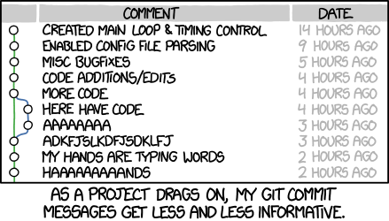
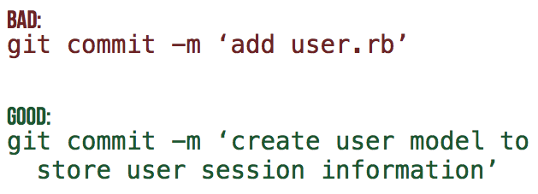
git commit best practices
ADVICE: Good commit messages
A good commit message usually contains a one-line description of the changes since the last commit and indicating their purpose
Informative commit messages will serve you well someday, so make a habit of never committing changes without at least a one-sentence description
http://docs.gitlab.com/ee/workflow/gitlab_flow.html
https://xkcd.com/1296/

Slide 17
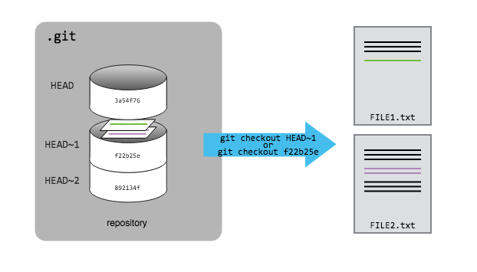
Anatomy of git commits
Each commit is identified by a unique “name” - SHA-1 hashtag
SHA-1 is an algorithm that takes some data and generates a unique string from it
SHA-1 hashes are 40 characters long
Different data will always produce different hashes
The same data will produce exactly the same hash

Slide 18
Exploring History
git log - lists all commits made to a repository in reverse chronological order.
Useful flags
-p – shows changes between commits
-3 – last 3 commits, any number works
--stat – shows comparative number of insertions/deletions between commits
--oneline – just SHA-1 and commit messages
--graph – prettier output
--pretty=short/full/fuller/oneline
--since=X.minutes/hours/days/weeks/months/years or YY-MM-DD-HH:MM
--until=X.minutes/hours/days/weeks/months/years or YY-MM-DD-HH:MM
--author=<pattern>

Slide 19
Exploring changes
Exactly what changes have you made?
git diff – shows all changes that have been made from a previous commit, in all files
git diff R/modified.R - see your changes of a particular file
To see the differences between commits, use hashtags: git diff 0da42ba 5m5lpac
The differences between commits for a specific file can be checked using git diff HEAD~2 HEAD -- <file>

Slide 20
Undoing things: Unstaging
There are a number of ways that you may accidentally stage a file that you don't want to commit
git add password.txt
Check with status to see that it is added but not committed
You can now unstage that file with:
git reset password.txt
Check with status

Slide 21
Undoing things: discarding changes
Perhaps you have made a number of changes that you realize are not going anywhere. Add what you ate for breakfast to README.md. Check with status to see that the file is changed and ready to be added
You can now return to previous committed version with:
git checkout -- README.md
Check with status and take a look at the file
You can return to a version of the file in a specific commit
git checkout m5ks3l8 README.md
If you want to correct the last commit message, do
git commit --amend -m "New commit message"

Slide 22
Undoing things: removing from repo
Sometimes you may want to remove a file from the repository after it has been committed. Create a file called READYOU.md, and add/commit it to the repository
You can now remove the file from the repository with:
git rm READYOU.md
List the directory to see that you have no file named READYOU.md. Use git status to determine if you need any additional steps
What if you delete a file in the shell without git rm?
rm README.md
What does git status say?
Oops! How can you recover this important file?
git checkout -- README.md

Slide 23
Undoing things: the big “undo” button
It is possible that after many commits, you decide that you really want to "rollback" a set of commits and start over. It is easy to revert all your code to a previous version
You can use git log and git diff to explore your history and determine which version you are interested in. Choose a version and note the hash for that version
git revert b5l9sa4
Importantly, this will not erase the intervening commits. This will create a new commit that is changed from the previous commit by a change that will recreate the desired version. This retains a complete provenance of your software, and be compared to the prohibition in removing pages from a lab notebook

Slide 24
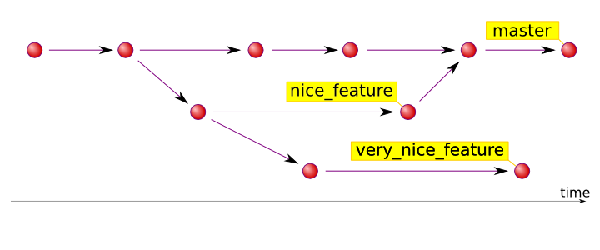
Branches
Branches are parallel instances of a repository that can be edited and version controlled in parallel, without disturbing the master branch
They are useful for developing a feature, work on a bug, try out an idea
If it works out, you can merge it back into the master
if it doesn’t, you can trash it
https://hades.github.io/2010/01/git-your-friend-not-foe-vol-2-branches/

Slide 25
A typical branch workflow
git branch – list current branch(es). An asterisk (*) indicates which branch you’re currently in.
git branch test_feature - create a branch called test_feature:
git checkout test_feature – switch to the test_feature branch
Make various modifications, and then add and commit.
git checkout master - go back to the master branch
git merge test_feature – combine changes made in the test_feature branch with the master branch
git branch –d test_feature – deletes the test_feature branch

Slide 26
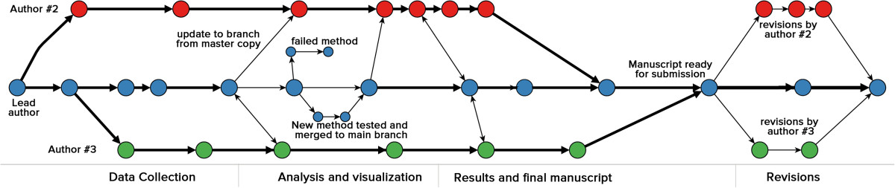
Branches for collaboration
Multiple authors can work on parallel branches, even on the same document
Conflicts must be resolved manually (using human intelligence)
Ram, Karthik. “Git Can Facilitate Greater Reproducibility and Increased Transparency in Science.” Source Code for Biology and Medicine 8, no. 1 (2013): 7. doi:10.1186/1751-0473-8-7.

Slide 27
Resolving conflicts
Conflicts may occur when two or more people change the same content in a file at the same time
Auto-merging README.md
CONFLICT (content): Merge conflict in README.md
Automatic merge failed; fix conflicts and then commit the result
The version control system does not allow people to blindly overwrite each other’s changes. Instead, it highlights conflicts so that they can be resolved. If you try to push while there are some changes, your push will be rejected, need to pull first. Pull, conflicts, resolve manually.
<<<<<<< HEAD
Your current changes
=======
Conflicting changes need to be resolved
>>>>>>> dabb4c8c450e8475aee9b14b4383acc99f42af1d

Slide 28



GitHub
https://octodex.github.com/

Slide 29
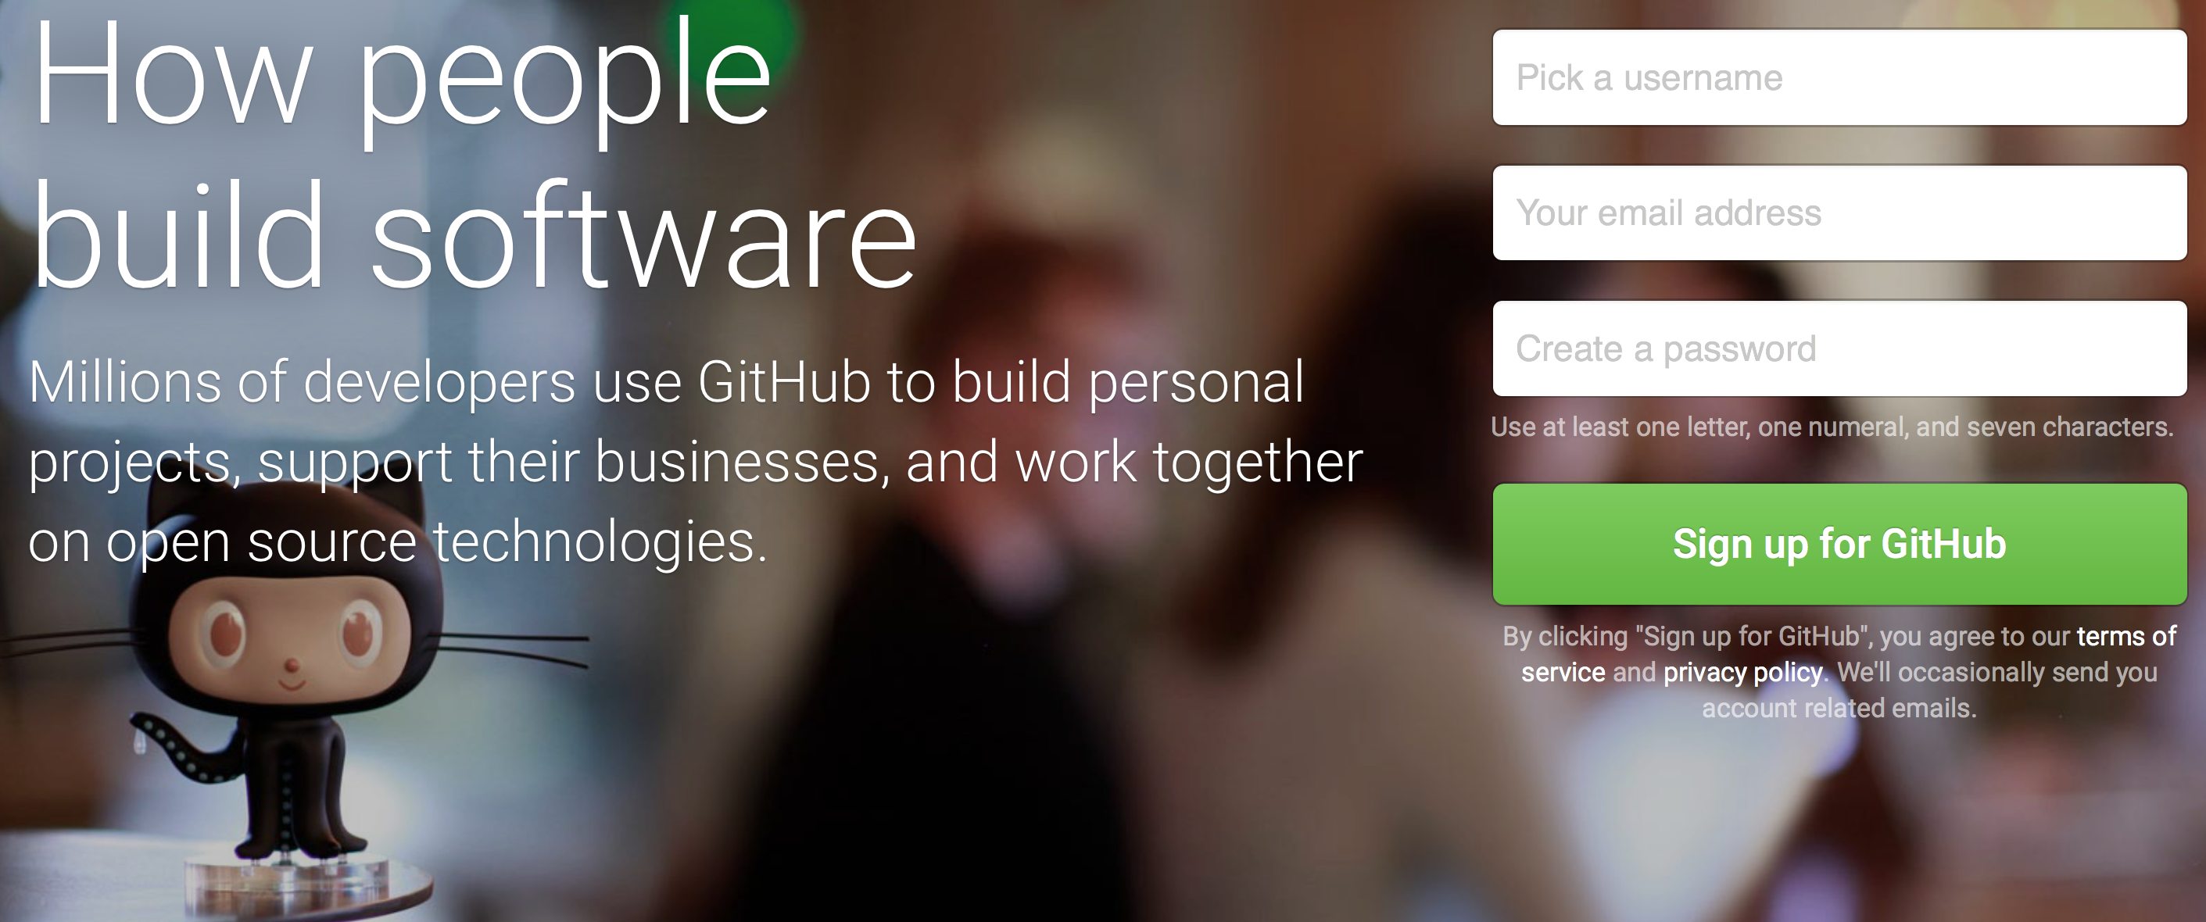
Collaboration the right way
GitHub is a hosting service where many people store their open (and closed) source code repositories. It provides tools for browsing, collaborating on and documenting code.
Like facebook for programmers
Free 2-year ”micro” account for students - https://education.github.com/ - free private repositories. Alternatively - Bitbucket, GitLab, gitolite
Exercise: Create a GitHub account, https://github.com/

Slide 30
Why use GitHub
True open source
Graphical user interface for git
Exploring code and its history
Tracking issues
Facilitates
Learning from others
Seeing what people are up to
Contributing to others’ code
Lowers the barrier to collaboration
”There’s a typo in your documentation.” vs.”Here’s a correction for your documentation.”

Slide 31
Remotes in GitHub
A local Git repository can be connected to one or more remote repositorie
git remote add origin https://github.com/username/reponame
Check your work git remote -v
Use the https:// protocol (not git@github.com) to connect to remote repositories until you have learned how to set up SSH
git push origin master - copies changes from a local repository to a remote repository
git pull origin master - copies changes from a remote repository to a local repository

Slide 32


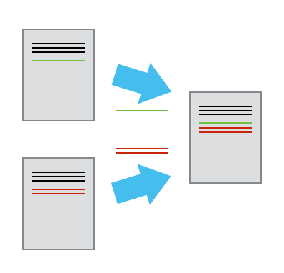
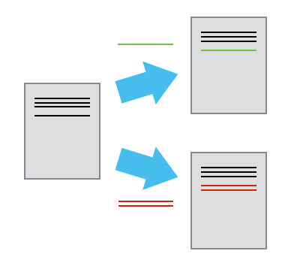
Asynchronous Collaborating
someone’s repository on GitHub – this is now YOUR copy
git clone it on your computer
Make changes, git add, git commit
git push changes to your copy
Create on GitHub

Slide 33
Keeping in sync with the owner’s repo
Add a connection to the original owner’s repository
git remote add upstream https://github.com/username/reponame # upstream - alias to other repo
git remote –v - check what you have
git pull upstream master – pull changes from the owner’s repo
Make changes, git add, git commit
git push – push your changes to GitHub.
Question: Where will they go? Can you do git push upstream master?

Slide 34


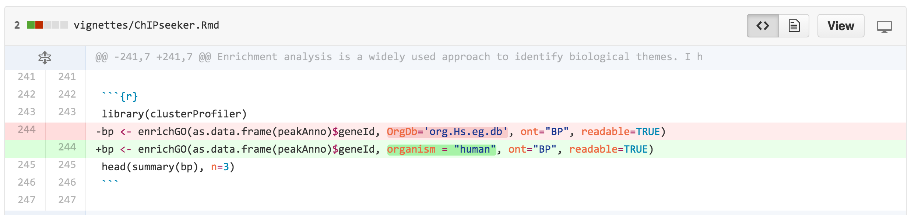
Create pull request
Go to your version of the repository on GitHub
Click the button at the top
Note that the owner’s repository will be on the left and your repository will be on the right
Click the button. Give a succinct and informative title, in the comment field give a short explanation of the changes and click the green button “Create pull request” again

Slide 35

What others see/do with pull requests
The owner goes to his version of the repository. Clicks on at the top. A list of pull requests made to his repo comes up
Click on the particular request. The owner can see other’s comments on the pull request, and can click to see the exact changes
If the owner wants someone to make further changes before merging, he add a comment
If the owner hates the idea, he just click the “Close” button
If the owner loves the idea, he clicks the “Merge pull request”

Slide 36
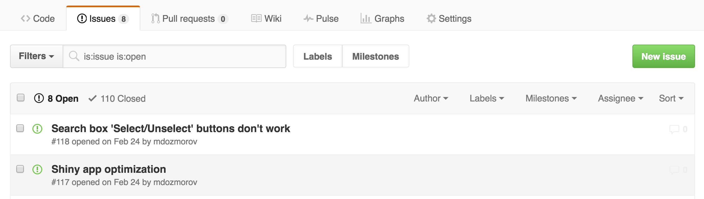
Track and resolve issues
Issues keep track of tasks, enhancements, and bugs for your projects
They can be shared and discussed with the rest of your team
Written in Markdown, can refer to @collaborator, #other_issue
Can use commit messages to fix issues, e.g., “Add missing tab, fix #100”. Use any keyword, “Fixes”, “Fixed”, “Fix”, “Closes”, “Closed”, or “Close”

Slide 37
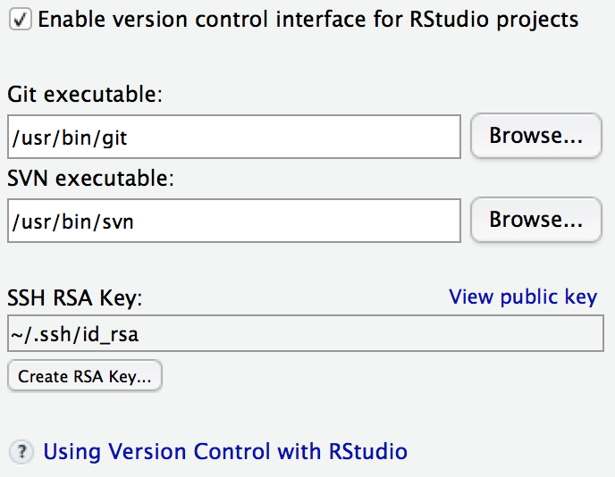
Rstudio and GitHub
RStudio has built-in facilities for git and GitHub. Set up git in Tools/Global Options
Your Rstudio project can be your git repository
Create a project with checkbox “Create a git repository” checked
Add existing project to version control by selecting git in Tools/Version control/Project setup

Slide 38
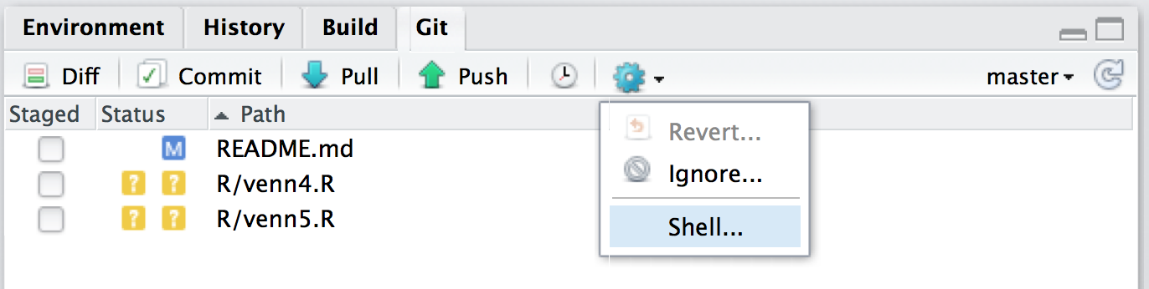
Rstudio and GitHub
Basic commands are available
See which files are untracked, modified, stage
What branch you are in
Add files, commit, push/pull
See differences, history
Revert changes, ignore files
For heavy lifting git, use shell

Slide 39
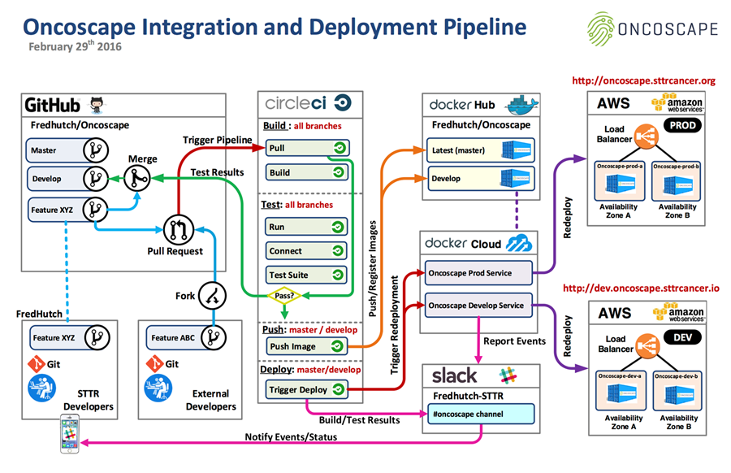
Big data analysis the right way
https://aws.amazon.com/blogs/aws/building-bridges-for-better-cancer-treatment-with-the-fred-hutchinson-cancer-research-center/

Slide 40
SEAMLESS INTERACTION WITH GITHUB
password-less login to any SSH connection

Slide 41

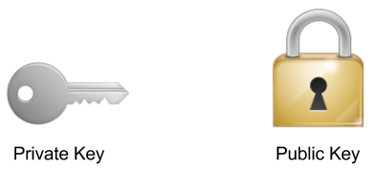
Encryption concepts
Public and private keys
Both public and private keys are generated by one individual – they are yours
A public key is a “lock” that can be opened with the corresponding private key
Public key can be placed on any other computer you want to connect to
Private key stays private on any machine you’ll be connecting from
Only your private key can “open” your public key
https://wogan.me/tag/public-key-encryption/
Notes:
https://wogan.me/tag/public-key-encryption/

Slide 42
Getting public and private keys
Generate your public and private keys
First, check if you already have them, ls -al ~/.ssh
If not, generate
ssh-keygen -t rsa -b 4096 -C your_email@example.com
~/.ssh/id_rsa
~/.ssh/id_rsa.pub
~/.ssh/authorized_keys
Notes:
https://wogan.me/tag/public-key-encryption/

Slide 43
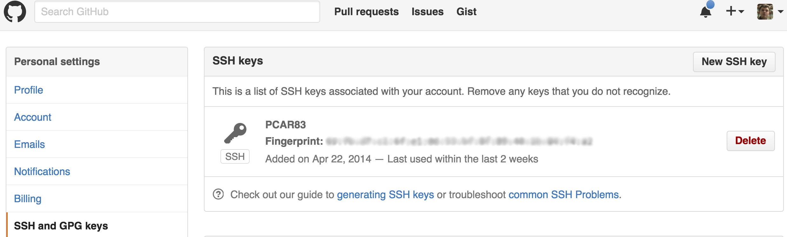
Add public key to GitHub
Add your public key to your GitHub account
Go to your GitHub Account Settings
Click “SSH and GPG keys” on the left.
Click “New SSH Key” on the right.
Add a label (like “My laptop”) and paste your public key into the text box.
Test it, ssh -T git@github.com. You should see something like “Hi username! You've successfully authenticated but Github does not provide shell access.”
https://help.github.com/articles/generating-an-ssh-key/
https://www.cs.utah.edu/~bigler/code/sshkeys.html

Slide 44
Add public key to any machine
Copy your public key ~/.ssh/id_dsa.pub to a remote machine
Add the content of your public key to ~/.ssh/authorized_keys on the remote machine
Make sure the .ssh/authorized_keys has the right permissions (read+write for user, nothing for group and all)
cat ~/.ssh/id_dsa.pub | ssh user@remote.machine.com 'mkdir -p .ssh; cat >> .ssh/authorized_keys; chmod 600 authorized_keys'
http://mah.everybody.org/docs/ssh

Slide 45
Password-less login
Your private key should be visible to your terminal session
Start SSH agent
Add auto-start function in your ~/.bashrc
# Start ssh-agent
SSH_ENV=$HOME/.ssh/environment
function start_agent {
echo "Initializing new SSH agent..."
# spawn ssh-agent
/usr/bin/ssh-agent | sed 's/^echo/#echo/' > "${SSH_ENV}"
echo succeeded
chmod 600 "${SSH_ENV}"
. "${SSH_ENV}" > /dev/null
/usr/bin/ssh-add
}
if [ -f "${SSH_ENV}" ]; then
. "${SSH_ENV}" > /dev/null
ps -ef | grep ${SSH_AGENT_PID} | grep ssh-agent$ > /dev/null || {
start_agent;
}
else
start_agent;
fi
http://mah.everybody.org/docs/ssh
https://gist.github.com/rezlam/850855

Slide 46
Copy files over ssh
scp <file> user@remote.host.com:~/work/
rsync –arvh –progress <file> user@remote.host.com:~/work/

